Slide 1
MLB Salary Prediction
Davis Grininger

Slide 2


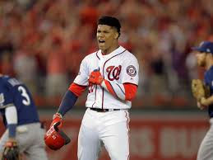
Why?

Slide 3
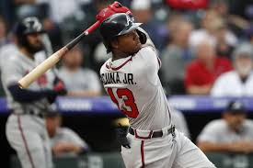
What I did
Linear Regression with a Large dataset
Cognitive Neural Net
Linear Regression with similar players to Ronald Acuna Jr.

Slide 4

Data Selection and Cleaning
Sean Lahman Baseball Database
Batters only. No pitchers
Data from 1985 to 2016
Adjusted for inflation
Offensive stats only (At Bats, Hits, Average, RBIs and Dingers)
Only qualifying players years
Data managed and cleaned with Pandas

Slide 5
Conclusions
CNN had the “cleaner” and more accurate model
Linear Regression works better with a tailored dataset
It is extremely difficult to predict players salaries
Off-field contributions
Because baseball

